Slide 1
Regional Economic Update
San Diego HR Forum
Presented by Chief Economist, Ray Major
January 18, 2022
Notes:
The San Diego region is a place focused on the future. Situated on the southwestern corner of the continental United States, it is a focal point of international trade; the U.S. Navy’s most strategic port and home to the nation’s largest military community; a tourism mecca; and a center for innovation in telecommunications, biotechnology, and other high-tech fields. Its robust economy makes the region a popular place with employers and employees alike. As it approaches mid-century, the San Diego region faces challenges common to many urban areas – congestion, a housing shortage and economic inequities, and environmental impacts associated with climate change. To capitalize on new economic opportunities in coming decades, the region must meet these challenges and overcome them. Investing in the San Diego region has yielded huge returns in the past, and investing in its future will no doubt do the same – opening up new horizons for prosperity in the 21st century.
The San Diego region has a rich heritage rooted in familial, cultural, linguistic, culinary, and educational connections between people on both sides of the border. Over the last century, economic and social progress was advanced as a result of deliberate decisions by real people in distinct moments. These visionaries imagined what our region’s future could become, long after they had passed on. The attributes that make our region a beautiful and dynamic place to live, work, and raise a family are the result of people who embraced our region’s potential.

Slide 2
COVID-19 is Driving the Regional Economy

Slide 3
COVID-19 is Driving the Regional Economy
COVID Variants
Labor Force Disruptions
Unemployment Rate 4.6% (November 2021)
Record Job Openings
Record Resignations
Inflation
PPI up 9.7% last 12 months
CPI up 7.0% last 12 months
Housing Prices
$825k median home price
Housing prices are up 24% since last year (October)
Mortgage Interest rates approximately 3.1%

Slide 4
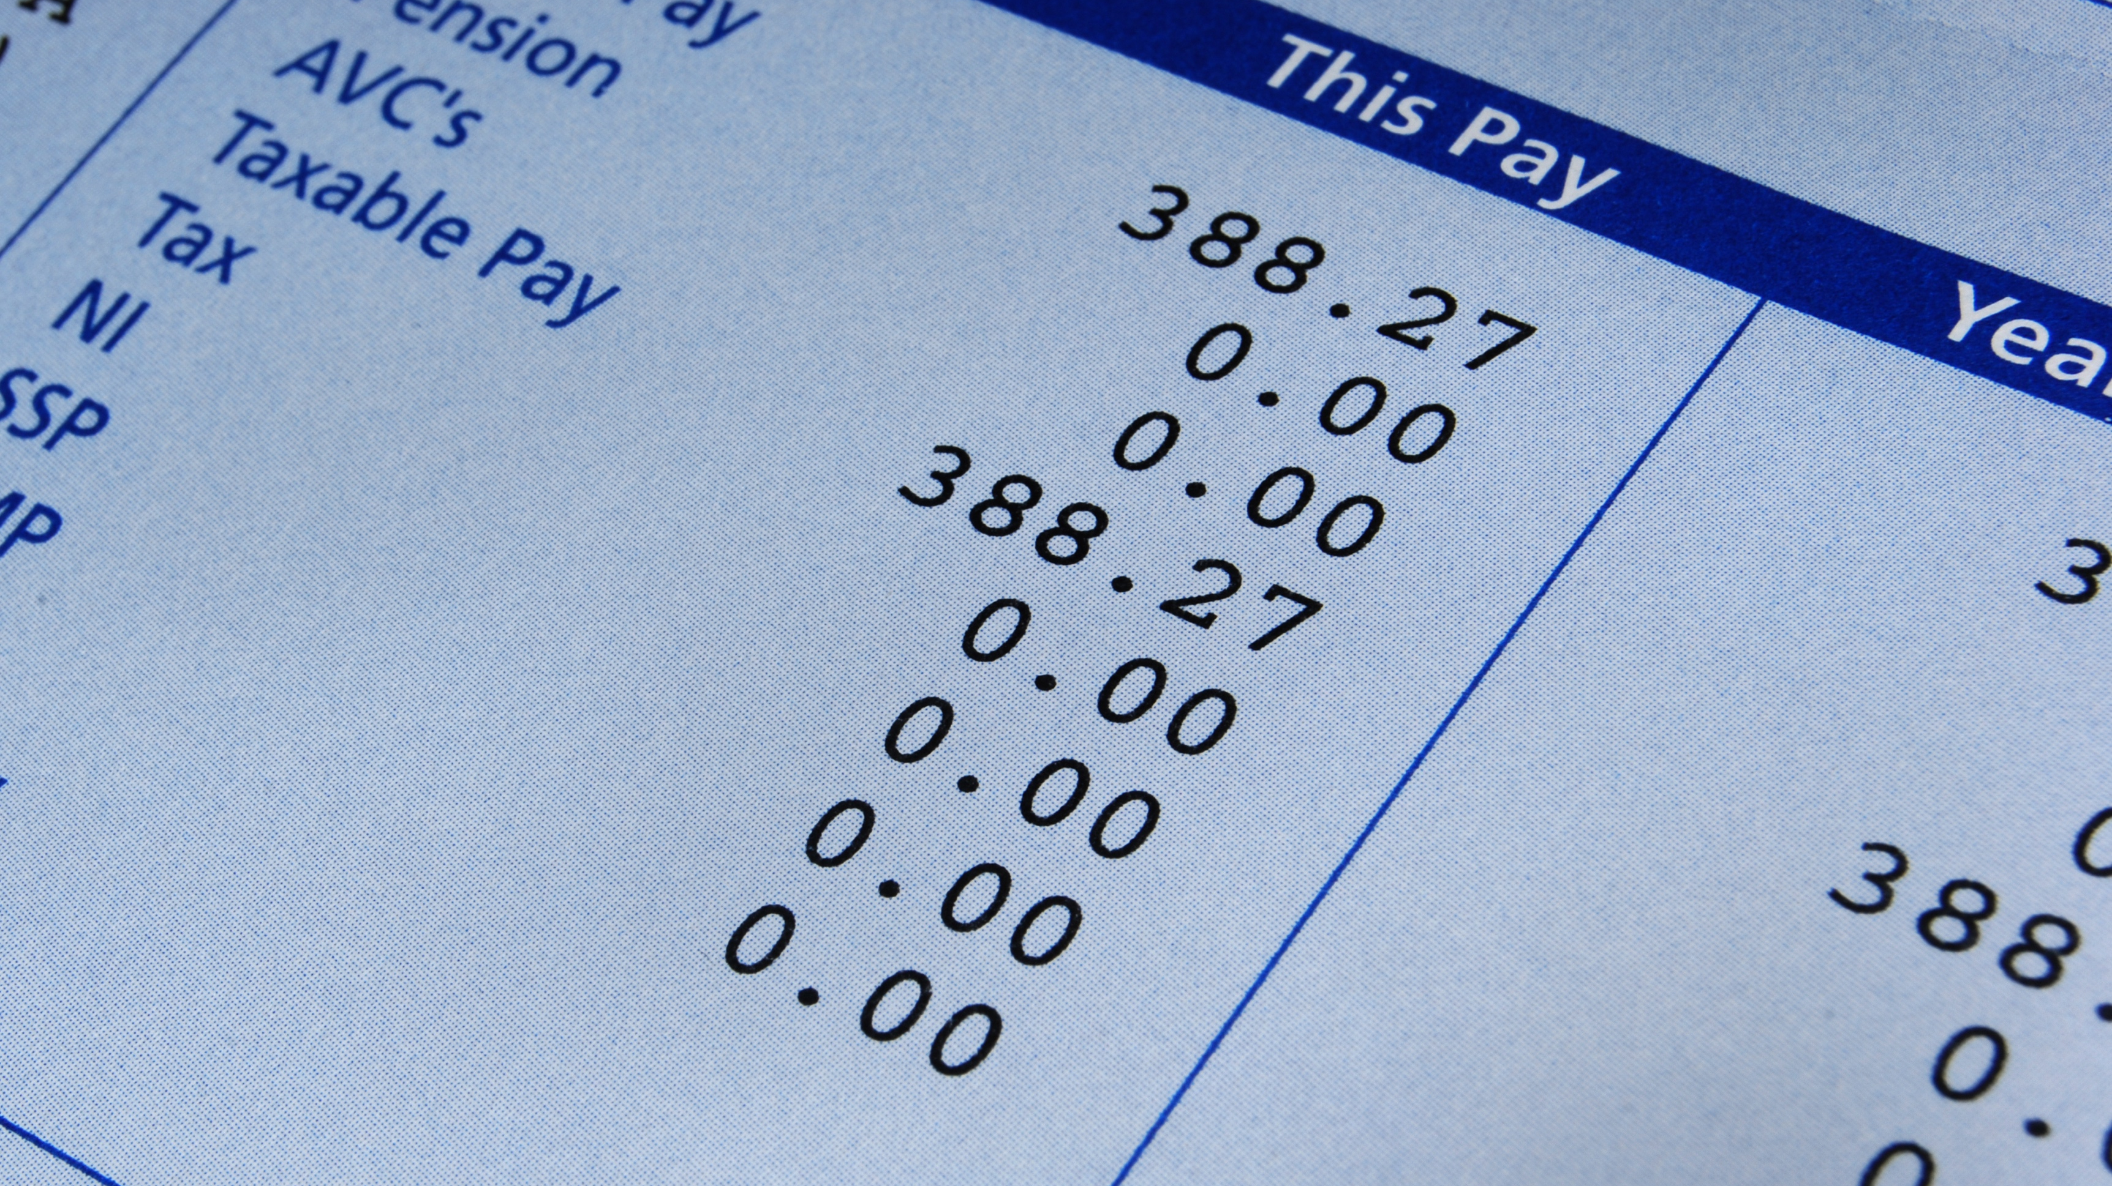
Inflation

Slide 5
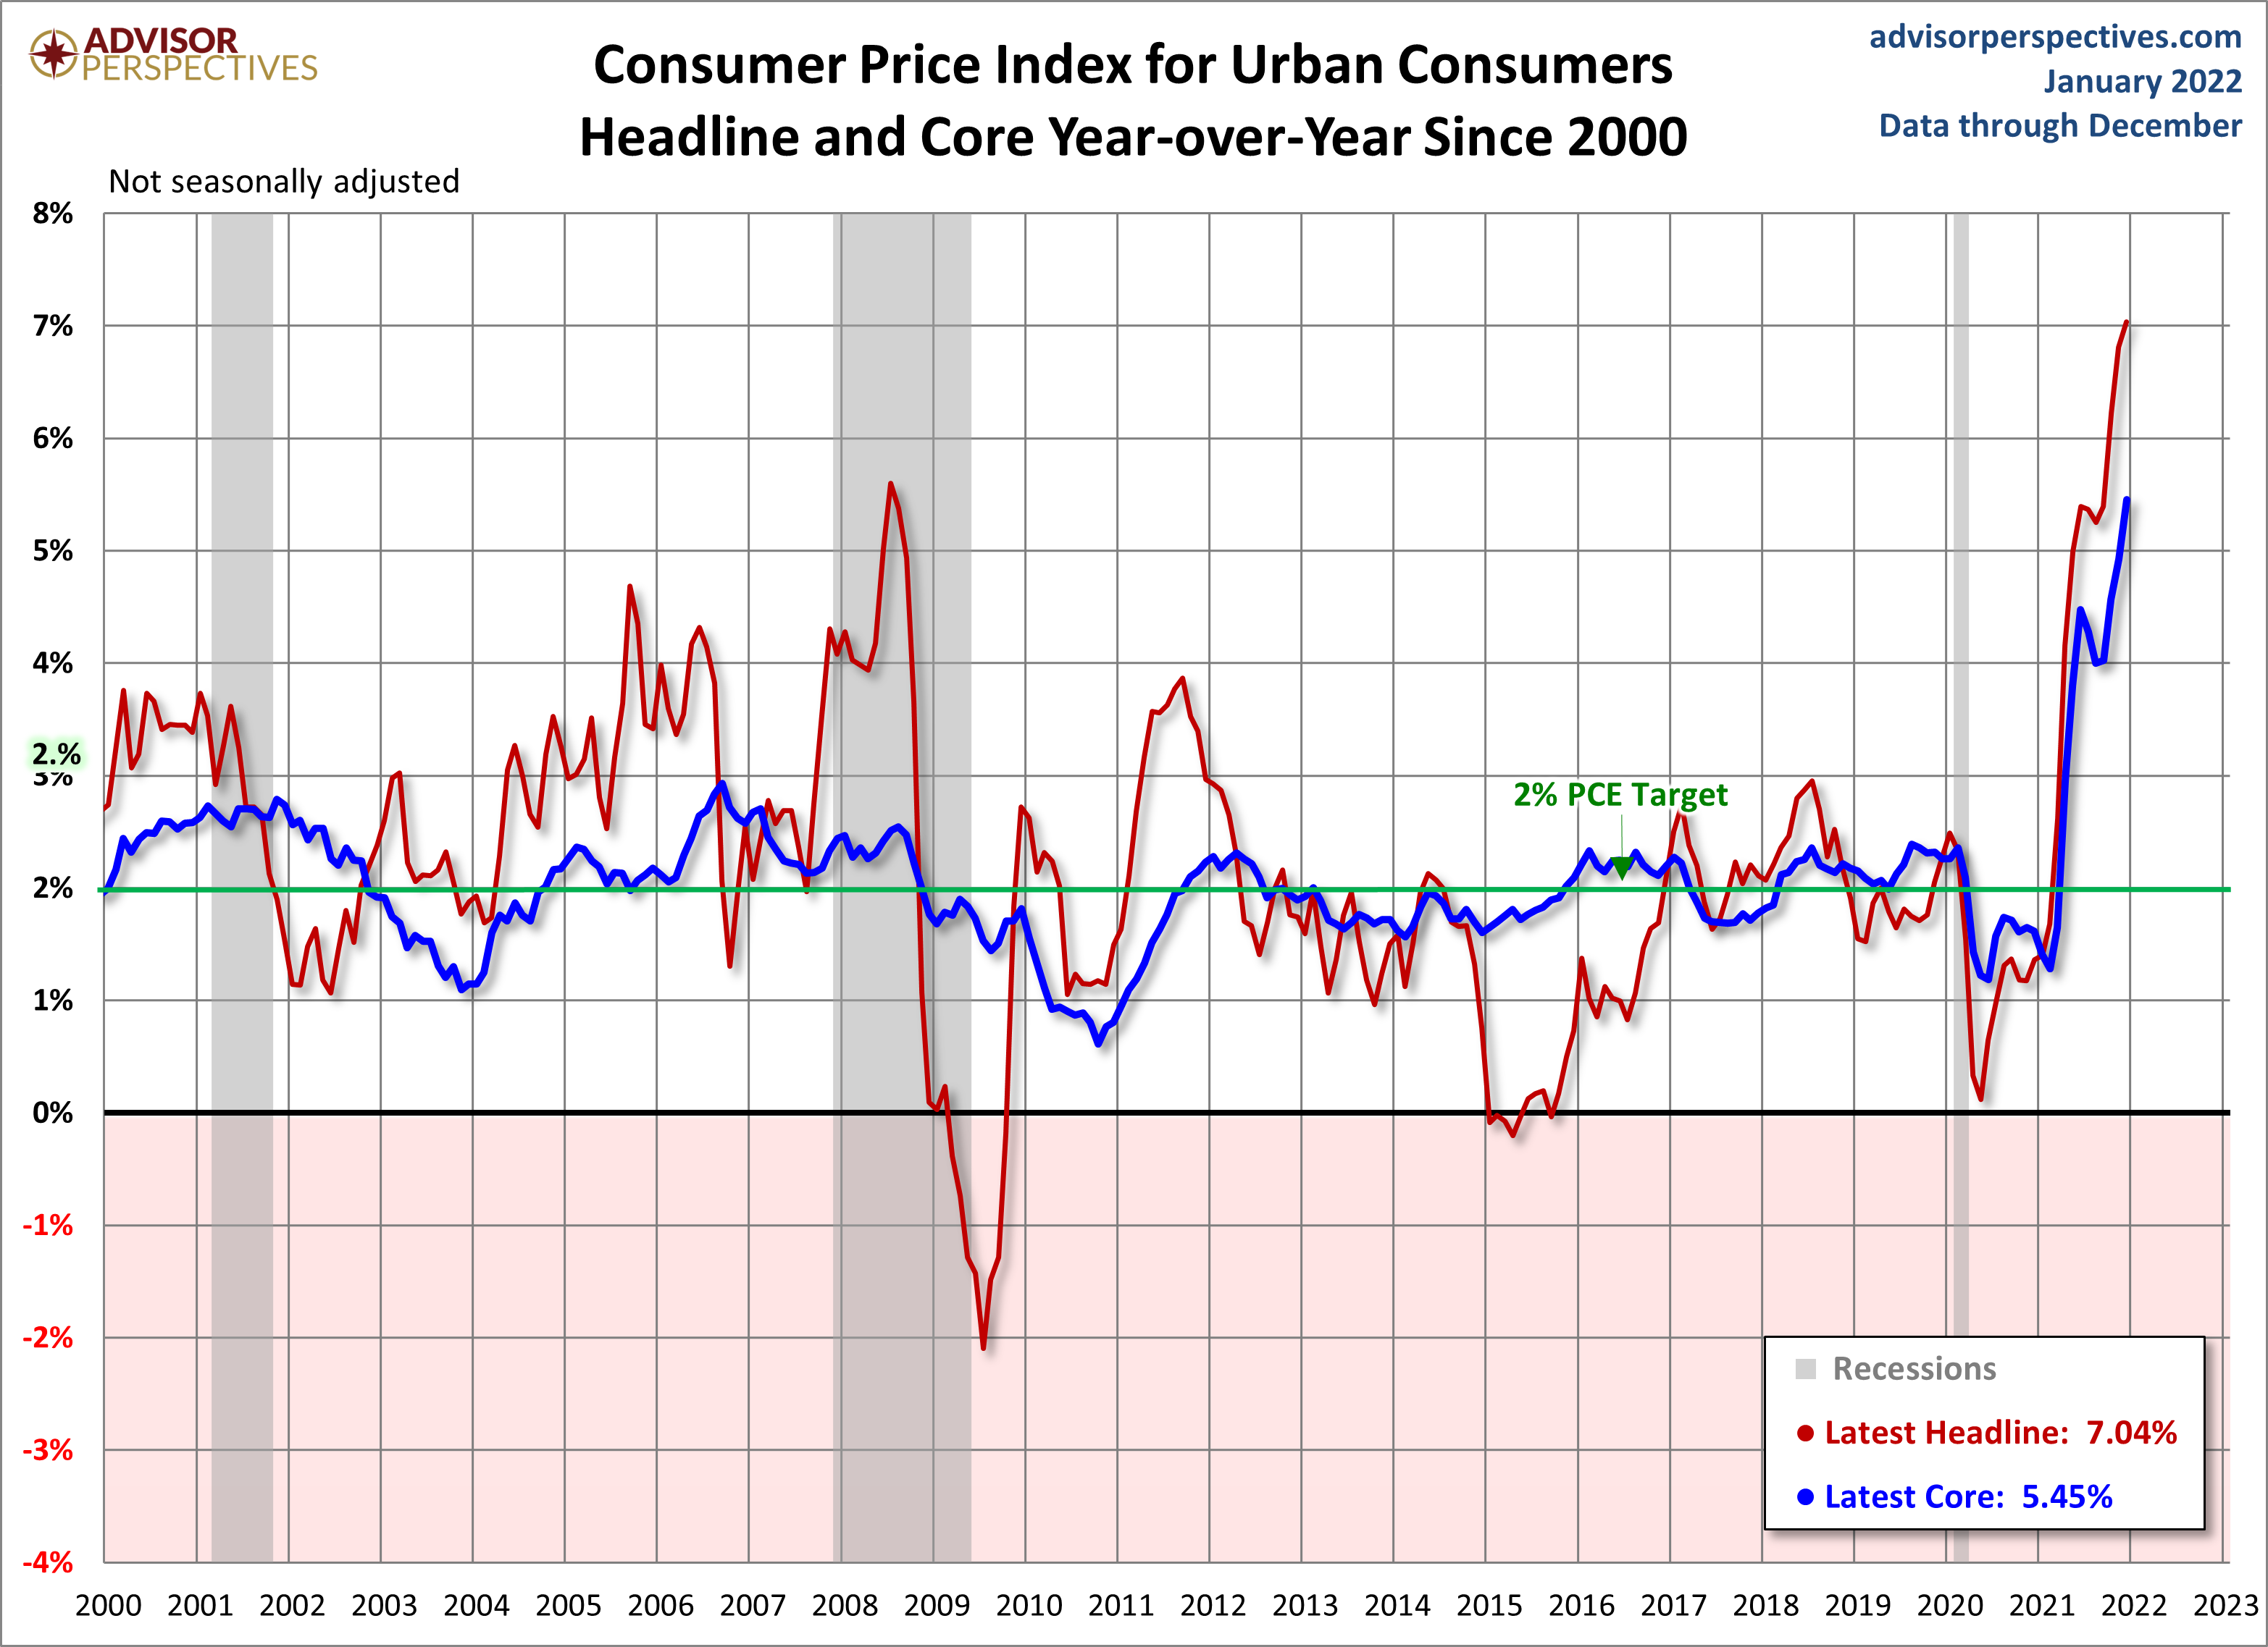
Consumer Price Index
PPI +9.7%
CPI +7.0%

Slide 6
Inflation by Category (Dec 2020 to Dec 2021)
Source: U.S. Bureau of Labor Statistics
Notes:
Source: BLS

Slide 7
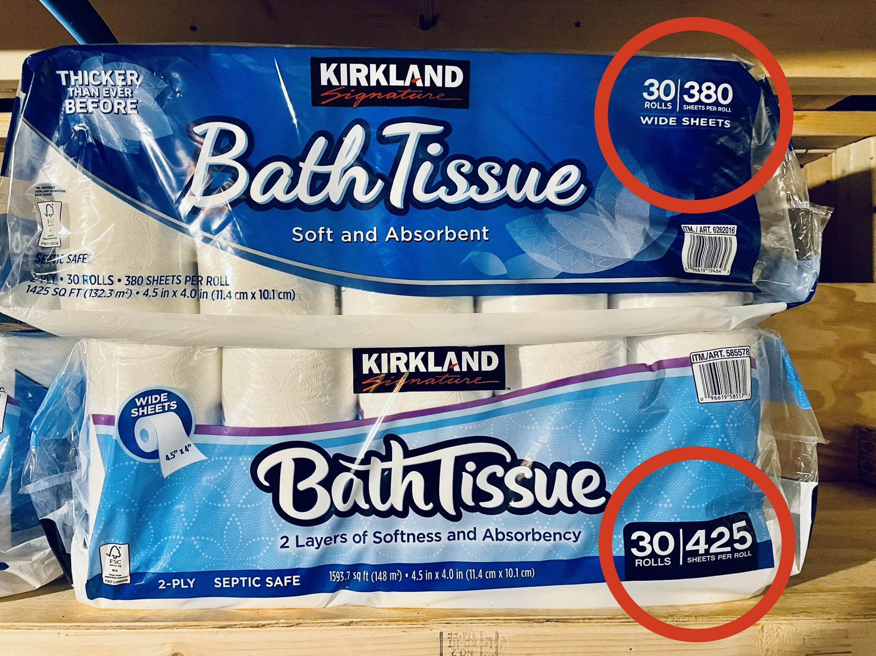
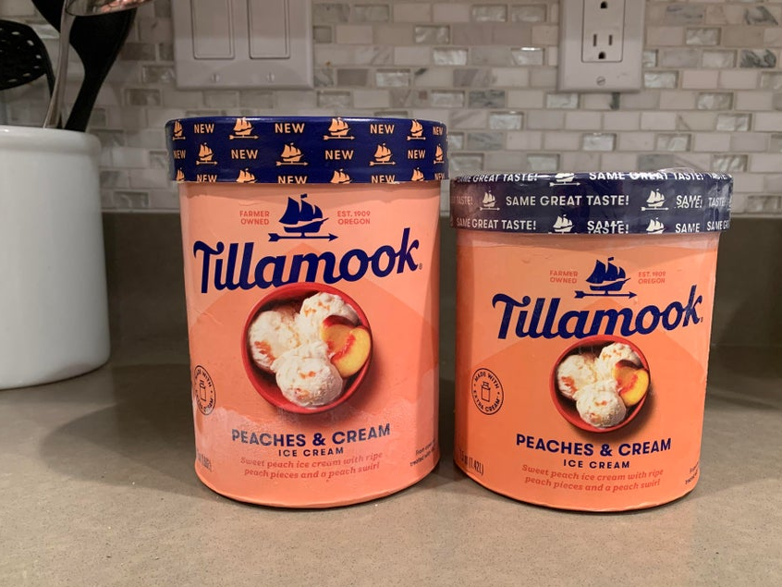
“Shrinkflation”
Current
Shrinkflation
11% Less Product
Same Price
Pre-Pandemic
Notes:
Economists have long noted that inflation can be overstated because it often doesn’t account for technological or quality improvements (cars, computers, phones, music services) that make the “same” items better.
But the reverse can also be true, especially in times of supply or worker shortage.
“Shrinkflation” is the practice of making the “same” product smaller without lowering the price. Classic example: candy bars. Others: “half gallon” of ice cream is probably 1.5 quarts, a quart of Gatorade is 28 oz, cereal boxes, toilet paper rolls.
“Skimpflation” is when a business stops providing a service but doesn’t lower prices, often due to staffing issues. Examples: missing hotel breakfasts, “fast casual” dining without waitstaff, Disneyland understaffing extending wait times and reducing tram services to parking lots (Disney has always understaffed, carefully measures how much inconvenience guests will tolerate; if you go to Disney, you are consenting to be treated like livestock).
Not all businesses can pass along cost increases, and especially small businesses are struggling to control costs and keep staff.
Cereal boxes (19.3 oz to 18.8 oz)
Ice cream
Disappearing hotel breakfasts
“Fast casual” dining
Disneyland
Small businesses struggling to contain costs

Slide 8
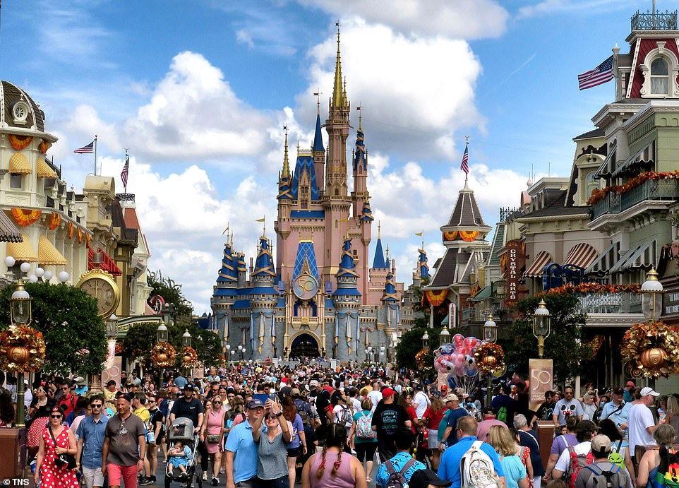
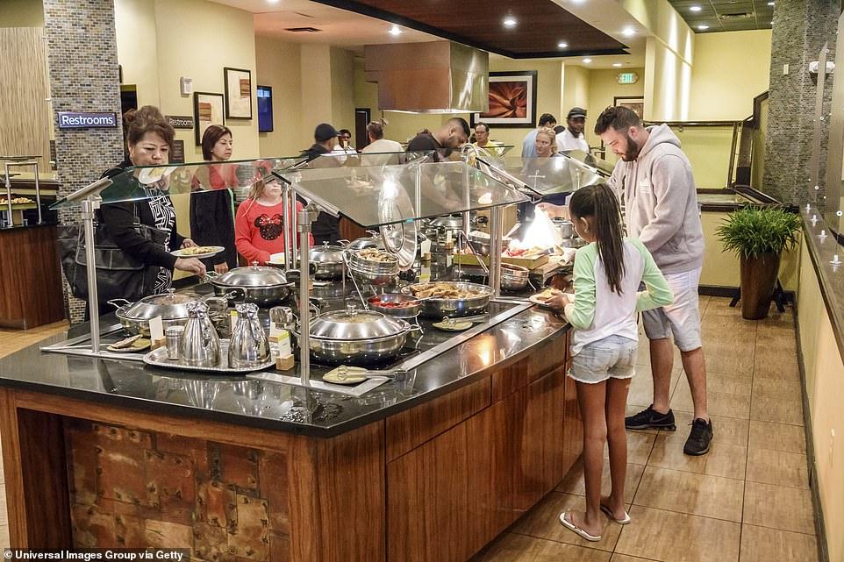
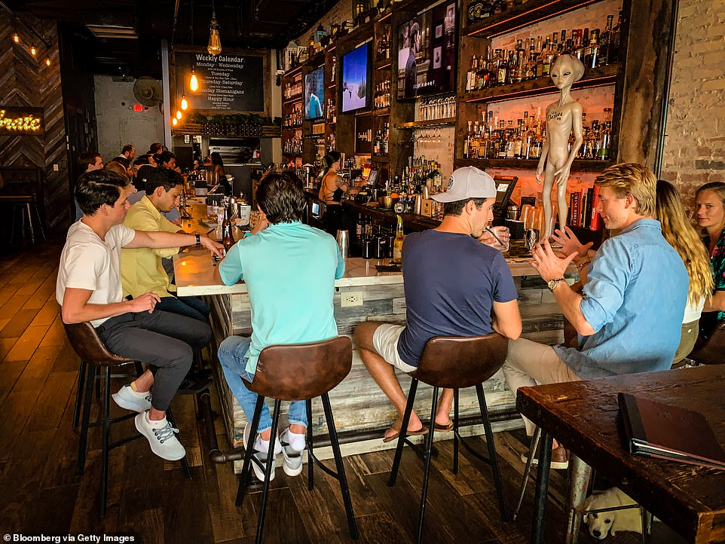
Skimpflation
Reduced Services
Longer lines
Longer wait times
Reduced staffing levels
Elimination of perks

Slide 9
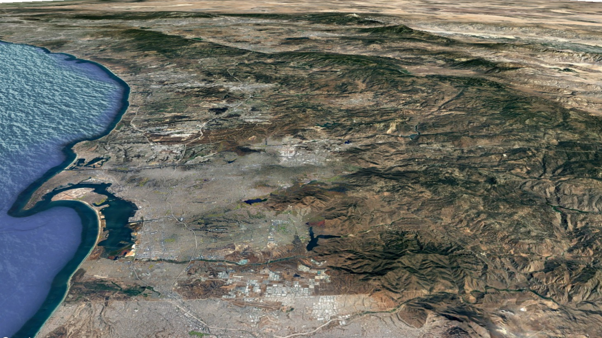
Supply Chain

Slide 10
Supply Chain Chaos Driving Inflation Bottlenecks in every link of the supply chain
Production
Covid shutdowns
Worker shortages
Lack of raw materials and components
Energy cost increases
.
Global Shipping
Shipping suddenly stopped then restarted; ships diverted to deliver personal protective equipment and essential goods.
Ports
Sudden shifts in volume
Worker/trucker shortage
Shortage/surplus of containers
Notes:
Supply side, “Lean” supply chains have become the norm – efficient but not resilient. Challenges at every point:
Production – Covid shutdowns, worker shortages, lack of raw materials and components, energy costs.
Global Shipping – Shipping suddenly stopped then restarted; ships diverted to deliver PPE and essential goods.
Ports – Sudden shifts in volume, worker/trucker shortage, shortage/surplus of containers.
Bottlenecks in every link of the supply chain.
“Lean” or “just-in-time” supply chains reduce warehousing costs by reducing inventories, but require reliable manufacturing and shipping. They are efficient but not resilient.
Manufacturers and distributors of goods cannot produce or supply as much as they did pre-pandemic for a number of reasons: worker shortages, lack of components and raw materials, cost increases, power shortages in China and energy cost rising elsewhere.
Global shipping halted and then restarted, with many ships diverted off usual routes to deliver PPE and other essential items. Return to normalcy is difficult. The backup of cargo ships heading toward Long Beach and Los Angeles is so bad that you can now see vessels waiting off the coast of San Diego. 90-100 ships waiting to get into ports.
Ports having difficulties: laid off workers, now need more. Space limited. Containers in the wrong places.

Slide 11
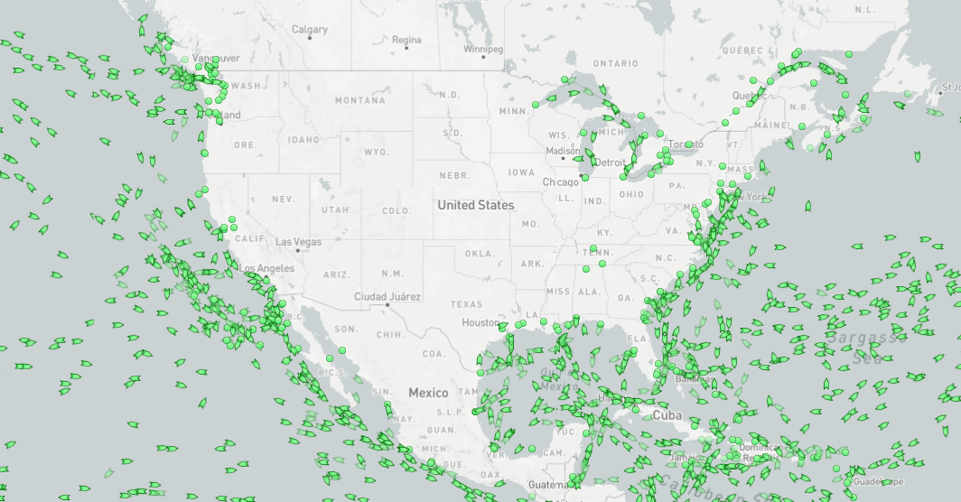
Container Ships Stuck in Traffic at Ports
Source: https://www.marinetraffic.com/en/ais/home/centerx:-98.6/centery:34.0/zoom:4
Notes:
jampacked container ships are stuck in traffic at ports, which is choking the economy. Delayed containers have become both a symptom of and a contributor to global supply chain problems.
Supply side, “Lean” supply chains have become the norm – efficient but not resilient. Challenges at every point:
Production – Covid shutdowns, worker shortages, lack of raw materials and components, energy costs.
Global Shipping – Shipping suddenly stopped then restarted; ships diverted to deliver PPE and essential goods.
Ports – Sudden shifts in volume, worker/trucker shortage, shortage/surplus of containers.
Bottlenecks in every link of the supply chain.
“Lean” or “just-in-time” supply chains reduce warehousing costs by reducing inventories, but require reliable manufacturing and shipping. They are efficient but not resilient.
Manufacturers and distributors of goods cannot produce or supply as much as they did pre-pandemic for a number of reasons: worker shortages, lack of components and raw materials, cost increases, power shortages in China and energy cost rising elsewhere.
Global shipping halted and then restarted, with many ships diverted off usual routes to deliver PPE and other essential items. Return to normalcy is difficult. The backup of cargo ships heading toward Long Beach and Los Angeles is so bad that you can now see vessels waiting off the coast of San Diego. 90-100 ships waiting to get into ports.
Ports having difficulties: laid off workers, now need more. Space limited. Containers in the wrong places.

Slide 12
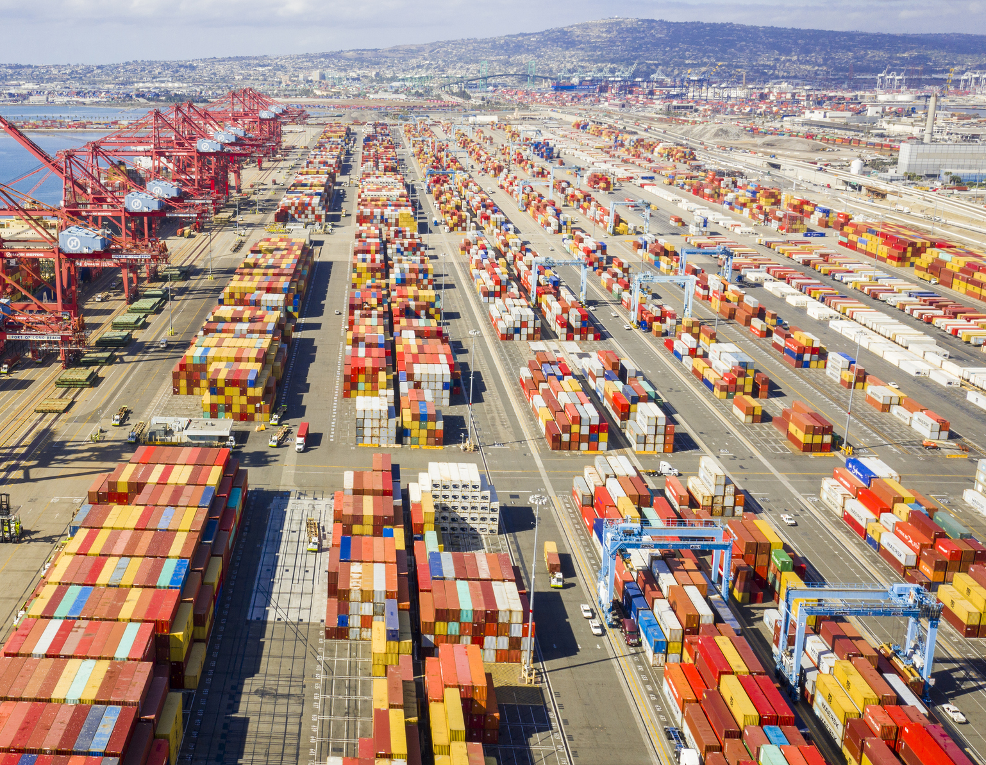
Supply Chain Backlog at Ports: 100+ ships 80,000 Truck Drivers ???? Price Increases Record High Demand Panic Buying / Hoarding Food Shortages

Slide 13
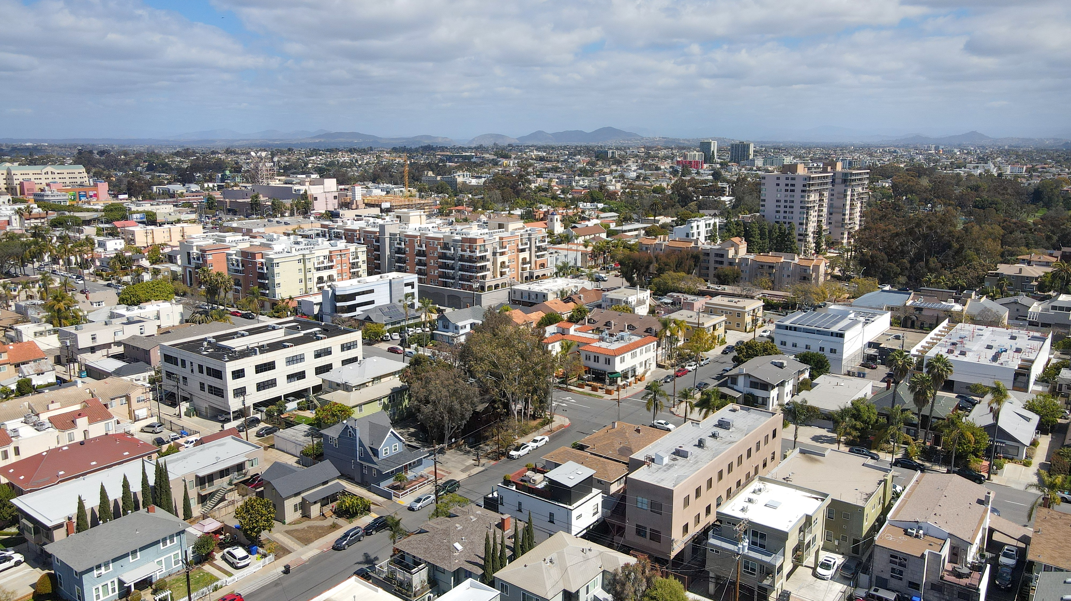
Housing

Slide 14
Home Prices Are Up
Home Prices
up 24%
in October 2021
compared to October 2020
Source: Case-Schiller Index
Inflation
Notes:
Avg price is $825K
Interest rate is ~ 3.1% (rate hikes could cool market)
Rents also up 11% in 2021 to $2,000 avg
Inventory at just over one month (4-6 months indicates balance)
Data is Case-Schiller in Covid Data tab

Slide 15
County House prices: Median Price (Existing single-family detached homes)
Expected increase 2022 (+16%)
(Goldman Sachs)
* Average up to November 2021 (+15%)
Source: California Association of Realtors (CAR), SANDAG
Notes:
Housing is getting more and more expensive in San Diego
Source: https://sandag.sharepoint.com/:x:/s/Economicanalysistemp/Efw-4YSiOIhEt4coPnFzZOYBBit6EvNnQa5fa9eqsu7b4g?e=H9BJG4

Slide 16
Residential Permits Issued
Carmel Valley, Poway/Rancho Bernardo, Eastlake
Mira Mesa, Scripps Ranch
Penasquitos, North Coast, San Marcos
70s Decade
80s Decade
Penasquitos, Scripps Ranch, Eastlake
San Luis Rey
2000s
90s Decade
As of mid-2021
2021
Source: Economic Research Bureau, Greater San Diego Chamber Of Commerce, Forecast Bulletin Economic Indicators (1970-1992); Real Estate Research Council (RERC) of Southern California, Real Estate and Construction Report (1993-2019)
Notes:
we don't build enough & price keeps increasing
There are housing unit shortages in the SD Region and the permits issued per year is well below the needed 12k per year
Source: https://sandag.sharepoint.com/:x:/s/Economicanalysistemp/EaAIFxhMZWJAgqqsraWnTaoBXBgfJipdgQHMjDiNzitO6Q?e=gr48oR

Slide 17
San Diego Region Housing Affordability Percentage of households that can afford to purchase a median-priced, single-family home
$860k
$850k
$800k
$750k
$700k
$650k
$600k
$550k
$500k
$450k
$400k
$350k
$300k
$250k
$200k
$150k
$100k
$50k
$0
$825K = median price
$159K = household income
56%
$623K = home price
$132K = household income
46%
23%
22%
$315K = home price
$66K = single income
11%
10%
Source: California Association of Realtors, Traditional Housing Affordability Index, SANDAG calculations
Notes:
Housing affordability is dropping in the SD region
Source: https://sandag.sharepoint.com/:x:/s/Economicanalysistemp/EXc-rLeY_25OtAh2SMWV47kBKDqw48pezM8LnYS16nKDNw?e=bvINwk
Assumes mortgage at 3.10 113,000 = county mean labor income
Stephanie has redone the right side using HH median and mean income

Slide 18
Employment

Slide 19
San Diego Region’s Economic Composition
1940s
1960s
1980s
2000s
2020s
Tourism
DRIVING
SECTORS
(30%)
Innovation
Military
Healthcare
SUPPORTING
SECTORS
(28%)
Education
Government
Finance,
Insurance,
Real Estate,
Professional
TRADITIONAL
SECTORS
(42%)
Retail
Construction
Manufacturing
Transportation
Source: SANDAG calculation based on State of California Employment Development Department Labor Market Information – Industry Employment and Labor Force, and Quarterly Census of Employment and Wages for San Diego-Carlsbad Metropolitan Statistical Area 2019. Note: Due to rounding, sum of numbers shown in chart equal more than 100%
| 19
Notes:
Change in the economic composition of the SD region. SD region is quite well balanced which helped survive the covid impact on the economy
Link : https://sandag-my.sharepoint.com/:x:/g/personal/dbe_sandag_org/EcIq4jX0EUZClYAuJF6VS60BH9pY0xXzp_MDXKOjpGBglg?e=o669hx

Slide 20
Employment Sector Estimates (as of November 2021)
COVID-19 Disruption
SUPPORTING SECTORS
Health Care
Education
Government
DRIVING SECTORS
Tourism
Innovation
Military
TRADITIONAL SECTORS
Retail/Wholesale Trade
Professional
Construction
Manufacturing
Transportation & Utilities
Great Recession
2007
Peak
2010
Trough
Feb 2019
Peak
Nov 2021
| 20
Source: CA Employment Development Department (EDD), Labor Market Information Division, Quarterly Census of Employment and Wages; SANDAG
Notes:
We see that the driving sector was the hardest hit by the pandemic. While the impacts of the pandemic are still being felt, we already appear to notice a faster rate of recovery following the pandemic driven recession than we did following the great recession. Most notable is the recovery seen by Traditional sectors which have nearly returned to pre-pandemic employment levels. Following the recession it took the same sector nearly 9 years to return to pre-recession levels.

Slide 21
Labor Force

Slide 22
COVID-19 Impact on workforce participation
 | Alpha | Gen Z | Millennials | Gen X | Boomers | Traditionalists
Years Born: | 2020-2007 | 2006-1996 | 1995-1978 | 1977-1966 | 1965-1946 | Pre-1945
Age Range: | 0-15 | 16-26 | 27-44 | 45-56 | 57-66 | 67+
Life Cycle: | n/a | Entry Level | Core Workforce` | Managers | Executives | Institutional knowledge
Work is: | n/a | Constantly evolving | A means to an end | A difficult challenge | Expected | An Obligation
Motivation: | n/a | Structure and stability | Freedom and Flexibility | Work-Life Balance | Job Security | Home Ownership
Changing Jobs: |  | Constantly | Is expected | If necessary for compensation | Loyal to employer Connect to values | Stay for life
No / Virtual Experience
Great Resignation
Early Retirement
Retirement
2020
2030

Slide 23
Wages

Slide 24
Nominal Hourly Wages
Great Recession
COVID-19 Disruption
24
Source: California Employment Development Department

Slide 25
Real Hourly Wages
Great Recession
COVID-19 Disruption
Source: California Employment Development Department

Slide 26
Spending

Slide 27
Spending Behavior Changed During Pandemic
March 2020
March 2020
(U.S. Retail Sales – Millions of Dollars)
(U.S. Retail Sales – Millions of Dollars)
Source: US Census Bureau
Notes:
Source: https://sandag.sharepoint.com/:x:/s/Economicanalysistemp/EV59dm0TZpJIg8dLx8nqsEQBxUe59WKC-FkNXGlNmj6Wng?e=NxhULf

Slide 28
Consumer Spending San Diego Region (% Change Jan 2020 to Nov 2021)
Jan 15
2020
First COVID-19 case detected in US
Apr 15
2020
First Stimulus
Payment
Jan 04
2021
Second Stimulus Payment
Jul 15
2021
Advanced Child
Tax Credit
Mar 17
2021
Third Stimulus
Payment
Mar 19
2020
CA issues stay at home order

Slide 29
U.S. Change in Spending (Q4 2019 through Q3 2021)
Durable
Goods
Nondurable
Goods
Financial
Services &
Insurance
Housing & Utilities
Food
Services
% Change
Other
Services
Healthcare
Transportation
Services
Recreation
Services
U.S. Bureau of Economic Analysis
Notes:
Note: This graph represents national spending levels
Durable goods things like cars, furniture, household appliances
Nondurable goods things like clothing, fuel, food, household supplies
Transportation services things like Car Repairs, Parking, Public Transportation, Air Transportation
Recreation services things like Sports centers, Membership clubs, Parks, Theaters
Typically, consumer spending on recreational activities moves closely in line with per capita disposable income and consumer spending; however, we are not currently seeing that relationship. This is likely due to the nature of the COVID-19 pandemic and how it is shaping consumers decision to spend their leisure time.
Recreation services include spending on membership clubs, parks, theaters, sports centers, gambling and other related services.
Source: https://sandag.sharepoint.com/:x:/s/infobitsfromRPM/EZ5Sr4KONOROouznI4tyhQ4B_H_rA1JoX-WJi8g6SV4NTA?e=ncxei6
Durable goods =
New motor vehicles
Net purchases of used motor vehicles
Motor vehicle parts and accessories
Furniture and furnishings
Household appliances
Glassware, tableware, and household utensils
Tools and equipment for house and garden
Video, audio, photographic, and information processing equipment and media
Sporting equipment, supplies, guns, and ammunition
Sports and recreational vehicles
Musical instruments
Jewelry and watches
Therapeutic appliances and equipment
Books, educational and recreational
Luggage and similar personal items
Telephone and facsimile equipment
Nondurable goods:
Food and nonalcoholic beverages purchased for off-premises consumption
Alcoholic beverages purchased for off-premises consumption
Food produced and consumed on farms
Men's and boys' clothing
Women's and girls' clothing
Children's and infants' clothing
Other clothing materials and footwear
Motor vehicle fuels, lubricants, and fluids
Fuel oil and other fuels
Pharmaceutical and other medical products
Recreational items
Household supplies
Personal care products
Tobacco
Magazines, newspapers, and stationery
Housing and utilities: typically increase by 3-5% a year. This year was in line with previous years.
Finance and insurance” spending increase less than in previous years
Transportation services include:
Motor vehicle services
Motor vehicle maintenance and repair
Other motor vehicle services
Motor vehicle leasing
Auto leasing
Truck leasing
Motor vehicle rental
Parking fees and tolls
Public transportation
Ground transportation
Railway transportation
Road transportation
Intercity buses
Taxicabs and ride sharing services
Intracity mass transit
Other road transportation service
Air transportation
Water transportation
Breakdown between food services and accommodation :
% change dollar change (billion)
Food services and accommodations -19% -196.708
Food services -12% -105.850
Accommodations -57% -90.858

Slide 30
Impacts of COVID-19

Slide 31
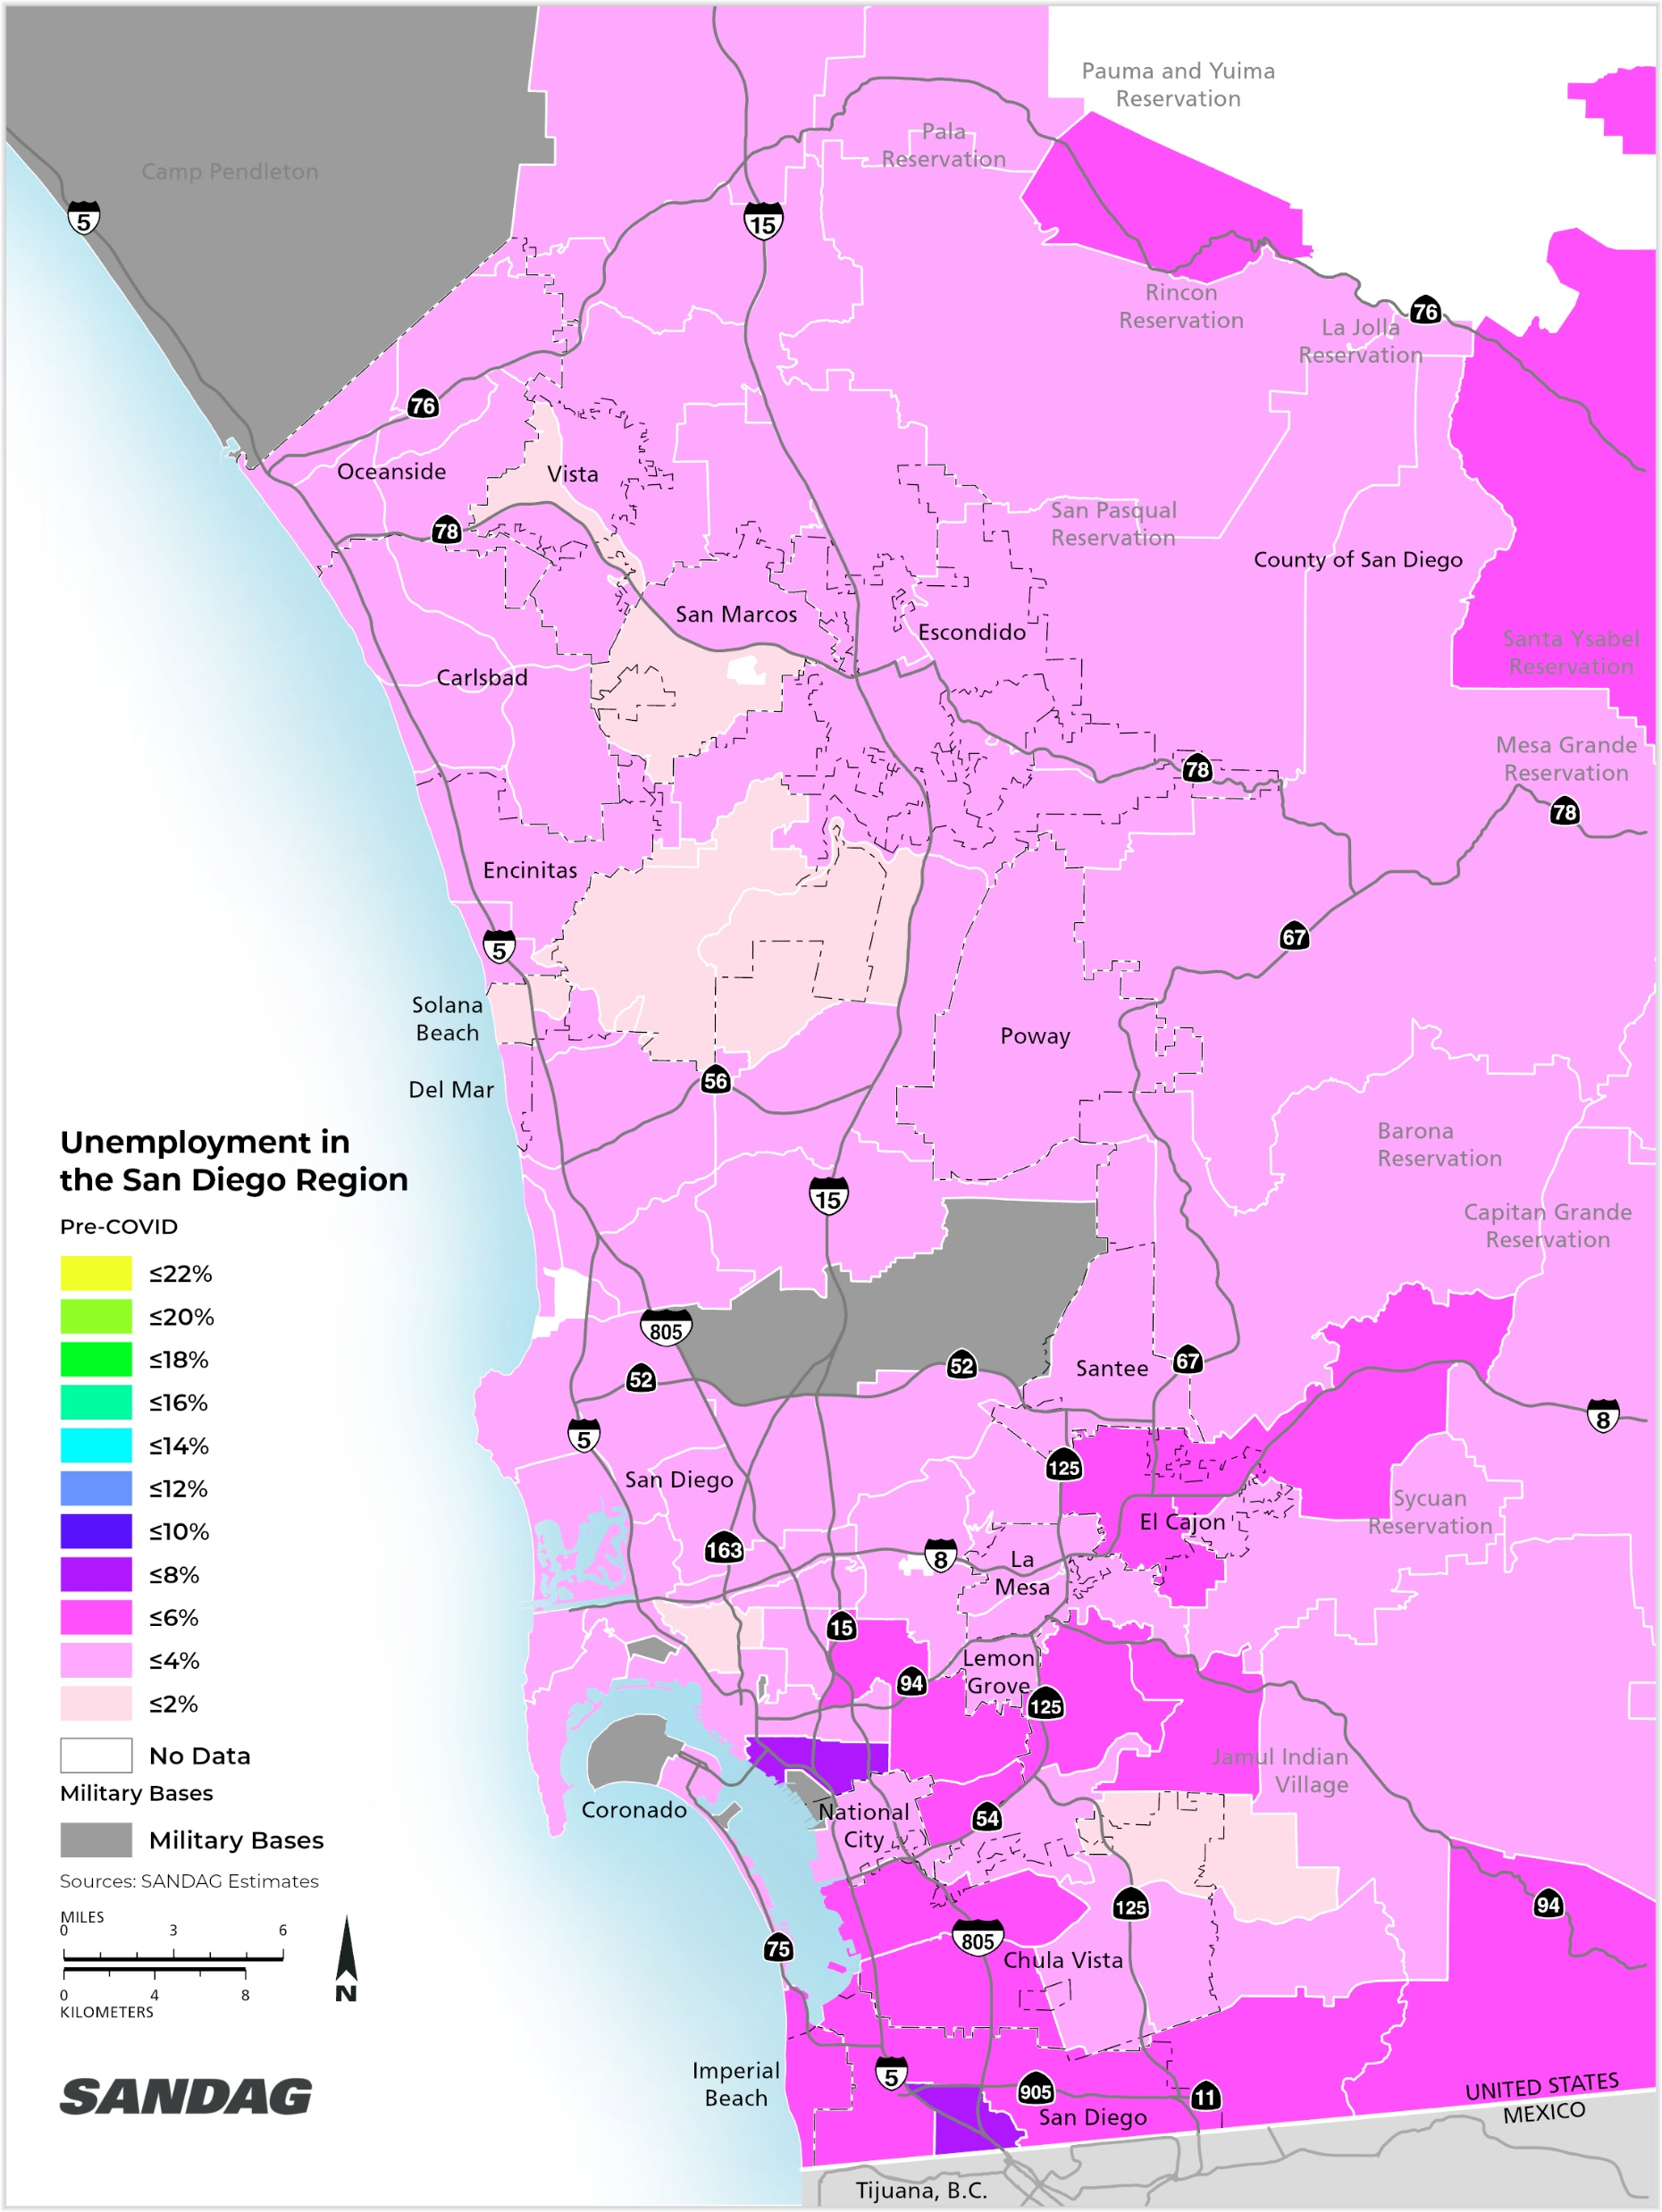
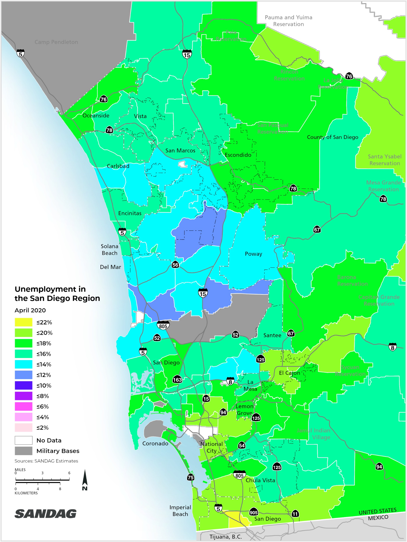
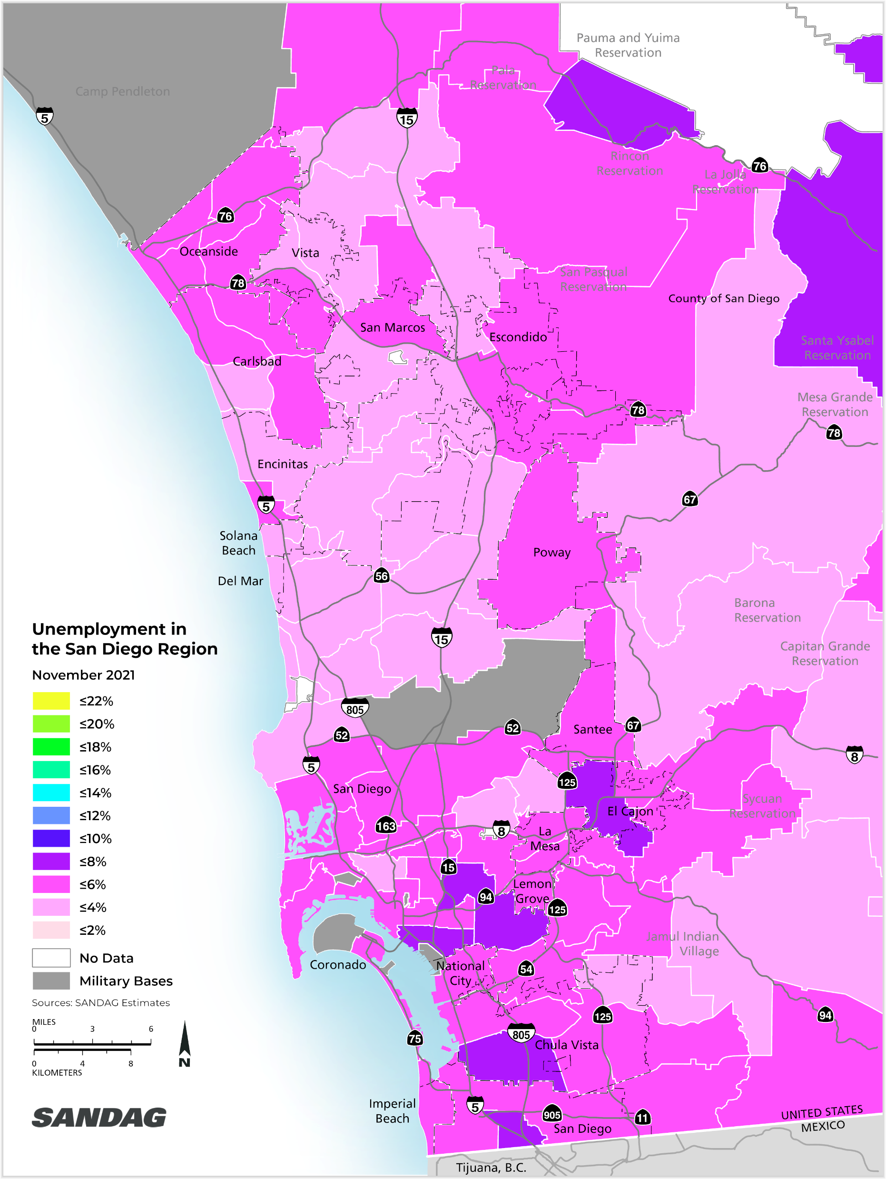
Most Impacted Communities: Unemployment
Pre-COVID (3.2%)
April 2021 (15.9%)
November 2021 (4.6%)
View SANDAG’s new interactive unemployment data tool online at: www.sandag.org/unemploymentdata

Slide 32
Employment During Recessions San Diego Region
Source: U.S. Bureau of Labor Statistics

Slide 33
Hardest Hit Sectors San Diego Region (Feb 2020 – Nov 2021)
65,300 total job loss
48,700 or 75% of total job loss fell into tourism, professional services, and education
Source: SANDAG Estimates based on Employment Development Department Labor Market Information Division data
Notes:
Tourism = Jobs like restaurant servers and hotel housekeepers
Professional Services = jobs like Finance and Real Estate like Realtors
Education = jobs like teachers includes people who provide training and instruction. Education sector also includes “educational support services" which capture people primarily engaged in providing noninstructional services that support educational processes or systems (IE: vocational rehabilitation counselors, education testing services, study abroad programs, etc)
Support staff who work at schools fall under different sectors.
https://www.census.gov/naics/?input=61&year=2017&details=61
New Data: Generated by the Unemployment estimates python script: unemployment_sectors_monthly_estimates
Old Data: https://sandag.sharepoint.com/:x:/s/Economicanalysistemp/ES8MQJMprylNoz28f26X6OcBkNVvQne3jTzvo7DxJKAreg?e=4%3ARvknGC&web=1&at=9&CID=5a3de886-4aac-bf66-ae30-2f154031c448 – in the chart sheet

Slide 34
Employment by Income Category San Diego Region (% change January 2020 to August 2021)
Median Income <$37k
-24.3%
Source: Paychex, Intuit, Earnin and Kronos

Slide 35
What to Expect in 2022
COVID-19 continues to drive the economy
Slowing rates of inflation, but still high given recent history
Continued labor force disruptions – resignations, unemployment, job openings
Sharp increases in wages
Businesses continue to struggle
Reduction in disposable personal income resulting in reduction in quality of life
Housing prices continue to stay high – interest rates stay low
Continued federal intervention

Slide 36
Stay connected with SANDAG
Explore our websites:
sandag.org
sdforward.com
iCommutesd.com
Follow us on social media: @SANDAGregion @SANDAG
Email: ray.major@sandag.org

