Slide 1
SDHR Forum
Peter Kim
VP, Culture and Counsel

Slide 2

Agenda
Defining Employee Engagement
Measure What Matters
Collecting and Responding to Feedback
Defining Roles
  HR
  Managers
  Leaders
Driving Accountability

Slide 3

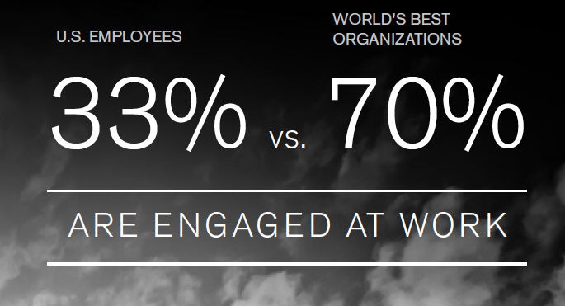
Why Does Engagement Matter
Highly engaged employees are:
22% More Productive

Slide 4
Defining Employee Engagement

Slide 5
What is Employee Engagement?
What is Employee Engagement?
EMPLOYEE ENGAGEMENT DEFINITION
Employee engagement is the extent to which
employees feel passionate about their jobs,
are committed to the organization,
and put discretionary effort into their work.

Slide 6
Employee Satisfaction vs. Employee Engagement
Employee engagement is not the same as employee satisfaction.
Satisfied employees are merely happy or content with their jobs and the status quo. For some, this might involve doing as little work as possible.
Engaged employees are motivated to do more than the bare minimum needed in order to keep their jobs.
Employee satisfaction…
  only deals with how happy or content employees are.
  covers the basic concerns and needs of employees.
  does not address employees’ level of motivation or involvement.

Slide 7
Components of Employee Engagement
There are two primary factors that drive employee engagement.
Engagement with the Organization measures how engaged employees are with the organization as a whole, and by extension, how they feel about senior management. This factor has to do with confidence in the organizational leadership, as well as trust, fairness, values, and respect – i.e., how people
like to be treated by others at work and outside of work.
Engagement with ”My Manager” is a
more specific measure of how employees relate to their direct supervisors. Topics include feeling valued, being treated fairly, receiving feedback and direction, and generally, having a strong working relationship between the employee
and manager based on mutual respect.

Slide 8


Employee Engagement Framework
HIGH PERFORMANCE
Culture of Engagement
Motivating and Retaining
Strategic Alignment
Managing and Executing
Is there a culture that motivates, empowers, challenges, and respects employees?
Do employees understand where the organization is headed and how they contribute to the organization’s success?
Do managers motivate employees to give their best? Are managers building strong relationships and developing cohesive teams?
Are managers clearly defining expectations, holding employees accountable, and focused on delivering results?
The two Organization factors deal with how employees relate to and connect with the organization.
The two
Manager factors look at whether managers display the essential skills and behaviors needed to be effective.
Barriers to Growth
What other things could impede your organization’s ability to grown and/or execute its strategy?

Slide 9
Employee Engagement - Maturity Model
Engagement 1.0
Engagement 2.0
Engagement 3.0
The top-down annual engagement survey
Pulse surveys with intelligent sensing
Intelligent nudges, Focus on everyone
Once per year. Focus on management. Rigid questions asked year after year.
Focus on Benchmarking
Agile survey as needed. Pulse regular basis. Feedback on mobile or apps. AI-based action plans. Immediate feedback.
Focus on Feedback
Many sources of data. Recommendations driven by nudge and suggestion. Open to HRMS, and other behavioral data.
Focus on Action

Slide 10
Measure What Matters

Slide 11
2030 Vision
The unrivaled leader in serving science,
with revenues of $50 billion
One of the world’s most admired companies
An incredibly talented global team that brings diverse
perspectives, collaborative energy and a passion
to excel every day
Our customer-centric culture delivers a unique value
proposition and sustained competitive advantage
Our unwavering commitment to innovation and
to leadership in digital science enables our
customers to make the world healthier,
cleaner and safer
An exceptional track record of consistently
delivering strong financial performance
The world leader in serving science

Slide 12
What We Measure
2030 Vision
Continuous Improvement
Diversity and Inclusion
Customer Experience
Clarity of Direction
Emotional Commitment
Leadership and Manager Effectiveness
Role Model Leadership
Communication
Goal Setting
Feedback and Coaching
Employee Experience
Pride in Company
Recognition and Reward
Development Opportunities
Work Environment
Resources and Support
Teamwork

Slide 13
Collecting and Responding to Feedback

Slide 14
Survey Process and Responding to Feedback
2014 to 2018
2019
52 Questions
80% Response rate
41 Questions
75% Response rate
Nov.
Survey Launches
Dec.
Results shared with C-Suite
Jan
Results shared at Annual Leadership Team Meeting
Early Feb
CEO Sends All Employee Message
Late Feb
Managers Review Result

Slide 15
Defining Roles

Slide 16

Roles and Responsibilities
Leaders
Sets Expectations
Role Models Behaviors
Drives Accountability
HR
Coaches and Facilitates
Enables Action
Reinforces Accountability
People Manager
Reviews and Shares Results
Develops and Implements Actions
Commit to Improvements

Slide 17
Driving Accountability

Slide 18

Accountability Enablers
Annual Performance Reviews
Talent Cards (Succession Plans)
Special Coaching for Low Performers

Slide 19

The Hawthorne Effect
Western Electric manufacturing plan in 1920s
    Psychologists attempted to understand what conditions at work would improve productivity
Findings
    Turning the lights up improved productivity
    Turning the lights down also improved productivity
    It was the fact that management was paying attention to workers that improved engagement, focus, and productivity
  Do our managers care? And do they know what to do?

Slide 20
Role of Manager: Glint Research
7
Points
Higher
8x More likely to be engaged
Employees with managers who create action plans are 7% more engaged than their peers
Employees with managers who take action are 8x more likely to be rated “engaged” than those who do not
Action of Any Kind Matters
Glint research conduct with clients Spring 2019

Slide 21
Questions

